Slide 1
Key Management
This lecture is mainly based on the power point slides by Professor Lawrie Brown.
Notes:
Zili Shao

Slide 2
Key Management
Two classes of keys
  Short-term keys
    Symmetric key, such as DES, AES, RC6…
    Properties:
      Random and short lifetime.
  Long-term keys
    Asymmetric key, such as RSA,DSA…
    Properties:
      Long lifetime use for establish short-term keys.
CEG 260, Meilin Liu
Notes:
Zili Shao
The prime q and primitive root α can be common to all using some instance of the D-H scheme. Note that the primitive root α is a number whose powers successively generate all the elements mod q. Alice and Bob choose random secrets x's, and then "protect" them using exponentiation to create the y's. For an attacker monitoring the exchange of the y's to recover either of the x's, they'd need to solve the discrete logarithm problem, which is hard.

Slide 3
Key Management Problem
Key Generation
Key Distribution
  Distributing your own public key
  Obtaining someone else’s public key
    Certificate Authority…
Key storage
  Secure storage of keys
Revocation
  Revoke the key if it is compromised
  Determining whether a published key is still valid
CEG 260, Meilin Liu
Notes:
Zili Shao
The prime q and primitive root α can be common to all using some instance of the D-H scheme. Note that the primitive root α is a number whose powers successively generate all the elements mod q. Alice and Bob choose random secrets x's, and then "protect" them using exponentiation to create the y's. For an attacker monitoring the exchange of the y's to recover either of the x's, they'd need to solve the discrete logarithm problem, which is hard.

Slide 4
Key Distribution
Symmetric schemes require both parties to share a common secret key
Issue is how to securely distribute this key
Often secure system failure due to a break in the key distribution scheme
CEG 260, Meilin Liu
Notes:
Zili Shao
For symmetric encryption to work, the two parties to an exchange must share the same key, and that key must be protected from access by others. This is one of the most critical areas in security systems - on many occasions systems have been broken, not because of a poor encryption algorithm, but because of poor key selection or management. It is absolutely critical to get this right!

Slide 5
Key Distribution
Given parties A and B have various key distribution alternatives:
  A can select key and physically deliver to B
  Third party can select & deliver key to A & B
  If A & B have communicated previously can use previous key to encrypt a new key
  If A & B have secure communications with a third party C, C can relay key between A & B
CEG 260, Meilin Liu
Notes:
Zili Shao
The strength of any cryptographic system thus depends on the key distribution technique. For two parties A and B, key distribution can be achieved in a number of ways:
Physical delivery (1 & 2) is simplest - but only applicable when there is personal contact between recipient and key issuer. This is fine for link encryption where devices & keys occur in pairs, but does not scale as number of parties who wish to communicate grows. 3 is mostly based on 1 or 2 occurring first.
A third party, whom all parties trust, can be used as a trusted intermediary to mediate the establishment of secure communications between them (4). Must trust intermediary not to abuse the knowledge of all session keys. As number of parties grow, some variant of 4 is only practical solution to the huge growth in number of keys potentially needed.

Slide 6
Mutual Key Distribution
Offline key distribution
No efficiency
Delivery man required
For Key Encryption Key
CEG 260, Meilin Liu
Notes:
Zili Shao
The prime q and primitive root α can be common to all using some instance of the D-H scheme. Note that the primitive root α is a number whose powers successively generate all the elements mod q. Alice and Bob choose random secrets x's, and then "protect" them using exponentiation to create the y's. For an attacker monitoring the exchange of the y's to recover either of the x's, they'd need to solve the discrete logarithm problem, which is hard.

Slide 7
Center-Based Key Distribution
Typically have a hierarchy of keys
Session key
  temporary key
  used for encryption of data between users
  for one logical session then discarded
Master key
  used to encrypt session keys
  shared by user & key distribution center
CEG 260, Meilin Liu
Notes:
Zili Shao
The use of a key distribution center is based on the use of a hierarchy of keys. At a minimum, two levels of keys are used: a session key, used for the duration of a logical connection; and a master key shared by the key distribution center and an end system or user and used to encrypt the session key.

Slide 8
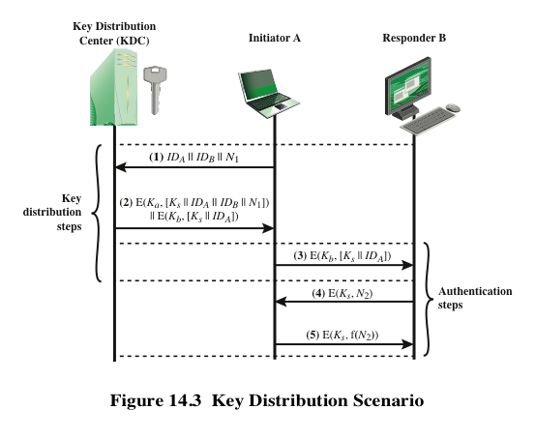
Notes:
The key distribution concept can be deployed in a number of ways. A typical
scenario is illustrated in Figure 14.3, which is based on a figure in [POPE79]. The
scenario assumes that each user shares a unique master key with the key distribution
center (KDC).

Slide 9
Hierarchical Key Control
For communication among entities within the same local domain, the local KDC is responsible for key distribution
  If two entities in different domains desire a shared key, then the corresponding local KDC’s can communicate through a global KDC
The hierarchical concept can be extended to three or more layers
Scheme minimizes the effort involved in master key distribution because most master keys are those shared by a local KDC with its local entities
  Limits the range of a faulty or subverted KDC to its local area only
Notes:
It is not necessary to limit the key distribution function to a single KDC. Indeed, for
very large networks, it may not be practical to do so. As an alternative, a hierarchy
of KDCs can be established. For example, there can be local KDCs, each responsible
for a small domain of the overall internetwork, such as a single LAN or a single
building. For communication among entities within the same local domain, the local
KDC is responsible for key distribution. If two entities in different domains desire a
shared key, then the corresponding local KDCs can communicate through a global
KDC. In this case, any one of the three KDCs involved can actually select the key.
The hierarchical concept can be extended to three or even more layers, depending
on the size of the user population and the geographic scope of the internetwork.
A hierarchical scheme minimizes the effort involved in master key distribution,
because most master keys are those shared by a local KDC with its local entities.
Furthermore, such a scheme limits the damage of a faulty or subverted KDC to
its local area only.

Slide 10
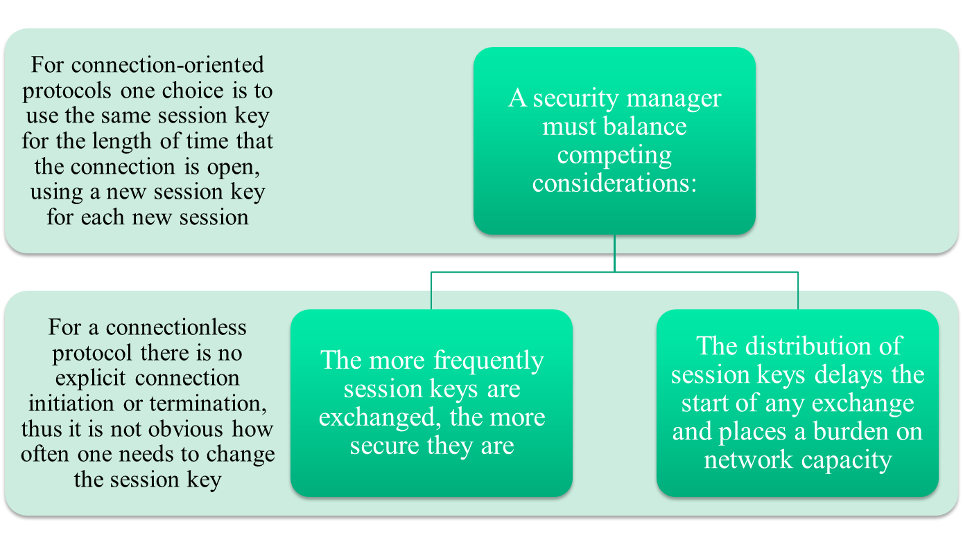
Session Key Lifetime
Notes:
The more frequently session keys are exchanged, the more secure they are, because
the opponent has less ciphertext to work with for any given session key. On the
other hand, the distribution of session keys delays the start of any exchange and
places a burden on network capacity. A security manager must try to balance these
competing considerations in determining the lifetime of a particular session key.
For connection-oriented protocols, one obvious choice is to use the same session
key for the length of time that the connection is open, using a new session key
for each new session. If a logical connection has a very long lifetime, then it would
be prudent to change the session key periodically, perhaps every time the PDU
(protocol data unit) sequence number cycles.
For a connectionless protocol, such as a transaction-oriented protocol, there
is no explicit connection initiation or termination. Thus, it is not obvious how often
one needs to change the session key. The most secure approach is to use a new session
key for each exchange. However, this negates one of the principal benefits of
connectionless protocols, which is minimum overhead and delay for each transaction.
A better strategy is to use a given session key for a certain fixed period only or
for a certain number of transactions.

Slide 11
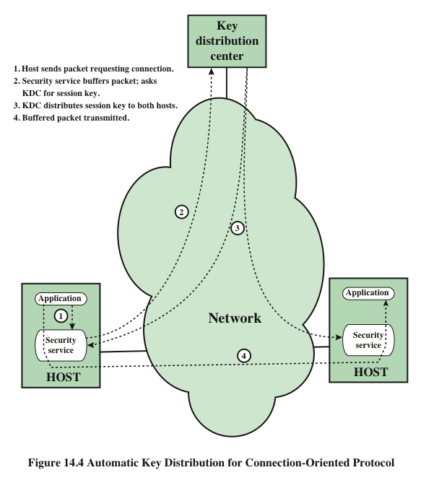
Notes:
The approach suggested in Figure 14.3 has many variations, one of which is
described in this subsection. The scheme (Figure 14.4) is useful for providing end-to-
end encryption at a network or transport level in a way that is transparent to
the end users. The approach assumes that communication makes use of a connection-
oriented end-to-end protocol, such as TCP. The noteworthy element of this
approach is a session security module (SSM), which may consist of functionality at
one protocol layer, that performs end-to-end encryption and obtains session keys
on behalf of its host or terminal.
The steps involved in establishing a connection are shown in Figure 14.4. When
one host wishes to set up a connection to another host, it transmits a connection-request
packet (step 1). The SSM saves that packet and applies to the KDC for permission
to establish the connection (step 2). The communication between the SSM and
the KDC is encrypted using a master key shared only by this SSM and the KDC. If the
KDC approves the connection request, it generates the session key and delivers it to
the two appropriate SSMs, using a unique permanent key for each SSM (step 3). The
requesting SSM can now release the connection request packet, and a connection is
set up between the two end systems (step 4). All user data exchanged between the two
end systems are encrypted by their respective SSMs using the one-time session key.
The automated key distribution approach provides the flexibility and dynamic
characteristics needed to allow a number of terminal users to access a number of
hosts and for the hosts to exchange data with each other.

Slide 12
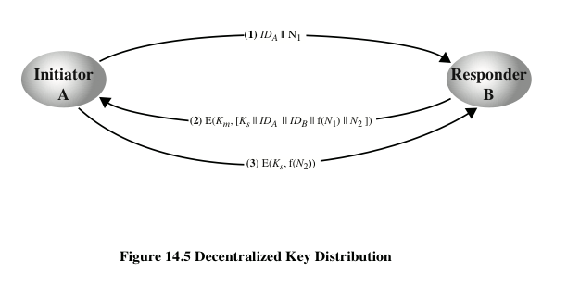
Notes:
The use of a key distribution center imposes the requirement that the KDC be trusted
and be protected from subversion. This requirement can be avoided if key distribution
is fully decentralized. Although full decentralization is not practical for larger
networks using symmetric encryption only, it may be useful within a local context.
A decentralized approach requires that each end system be able to communicate
in a secure manner with all potential partner end systems for purposes of
session key distribution. Thus, there may need to be as many as [n (n - 1)]/2 master
keys for a configuration with n end systems.
A session key may be established with the following sequence of steps
(Figure 14.5).
1. A issues a request to B for a session key and includes a nonce, N₁.
2. B responds with a message that is encrypted using the shared master key. The
response includes the session key selected by B, an identifier of B, the value
f(N₁), and another nonce, N₂.
3. Using the new session key, A returns f(N₂) to B.
Thus, although each node must maintain at most (n - 1) master keys, as many
session keys as required may be generated and used. Because the messages transferred
using the master key are short, cryptanalysis is difficult. As before, session
keys are used for only a limited time to protect them.

Slide 13
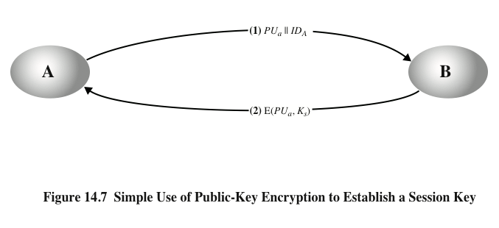
Simple Secret Key Distribution
Notes:
An extremely simple scheme was put forward by Merkle [MERK79], as illustrated in
Figure 14.7.
Despite its simplicity, this is an attractive protocol. No keys exist before the start of
the communication and none exist after the completion of communication. Thus,
the risk of compromise of the keys is minimal. At the same time, the communication
is secure from eavesdropping.

Slide 14
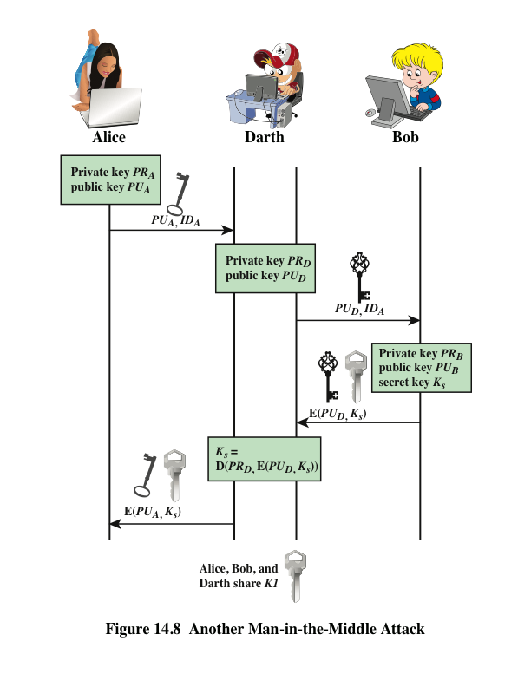
Man-in-the-Middle Attack
Notes:
The protocol depicted in Figure 14.7 is insecure against an adversary who
can intercept messages and then either relay the intercepted message or substitute
another message (see Figure 1.3c). Such an attack is known as a man-in-the-middle
attack [RIVE84]. We saw this type of attack in Chapter 10 (Figure 10.2). In the
present case, if an adversary, D, has control of the intervening communication channel,
then D can compromise the communication in the following fashion without
being detected (Figure 14.8).
Thus, this simple protocol is only useful in an environment where the only threat is eavesdropping.

Slide 15
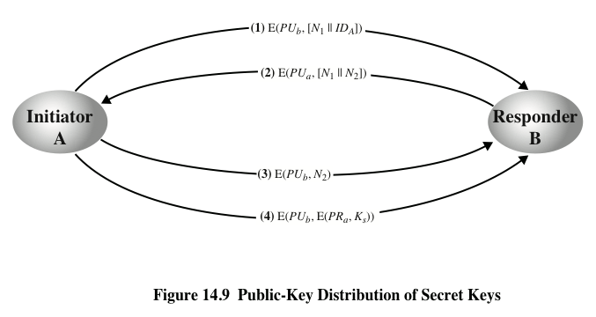
Secret Key Distribution with Confidentiality and Authentication
Notes:
Figure 14.9, based on an approach suggested in [NEED78], provides protection
against both active and passive attacks.
The result is that this scheme ensures both confidentiality and authentication
in the exchange of a secret key.

Slide 16
Public Key Management
Public-key encryption helps address key distribution problems
Have two aspects of this:
  Distribution of public keys
  Use of public-key encryption to distribute secret keys
CEG 260, Meilin Liu
Notes:
Zili Shao
One of the major roles of public-key encryption has been to address the problem of key distribution, with two distinct aspects: the distribution of public keys, and the use of public-key encryption to distribute secret keys.

Slide 17
Distribution of Public Keys
Distribution method of Public Keys
  Public Announcements
  Publicly available Directory
  Public-key Authority
  Public-key Certificates
CEG 260, Meilin Liu
Notes:
Zili Shao
The prime q and primitive root α can be common to all using some instance of the D-H scheme. Note that the primitive root α is a number whose powers successively generate all the elements mod q. Alice and Bob choose random secrets x's, and then "protect" them using exponentiation to create the y's. For an attacker monitoring the exchange of the y's to recover either of the x's, they'd need to solve the discrete logarithm problem, which is hard.

Slide 18
Public Announcement
Users distribute public keys to recipients or broadcast to community at large
  eg. append PGP keys to email messages or post to news groups or email list
Major weakness is forgery
  Anyone can create a key claiming to be someone else and broadcast it
  until forgery is discovered can masquerade as claimed user
CEG 260, Meilin Liu
Notes:
Zili Shao
The point of public-key encryption is that the public key is public, hence any participant can send his or her public key to any other participant, or broadcast the key to the community at large. Its major weakness is forgery, anyone can create a key claiming to be someone else and broadcast it, and until the forgery is discovered they can masquerade as the claimed user.

Slide 19
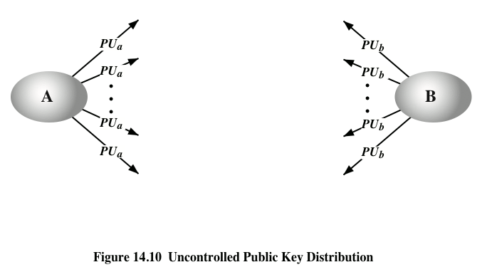
Public Announcement
Notes:
On the face of it, the point of public-key encryption is that the public key is public.
Thus, if there is some broadly accepted public-key algorithm, such as RSA, any participant
can send his or her public key to any other participant or broadcast the key to the
community at large (Figure 14.10). For example, because of the growing popularity of
PGP (pretty good privacy, discussed in Chapter 19), which makes use of RSA, many
PGP users have adopted the practice of appending their public key to messages that
they send to public forums, such as USENET newsgroups and Internet mailing lists.
Although this approach is convenient, it has a major weakness. Anyone can
forge such a public announcement. That is, some user could pretend to be user A
and send a public key to another participant or broadcast such a public key. Until
such time as user A discovers the forgery and alerts other participants, the forger is
able to read all encrypted messages intended for A and can use the forged keys for
authentication (see Figure 9.3).

Slide 20
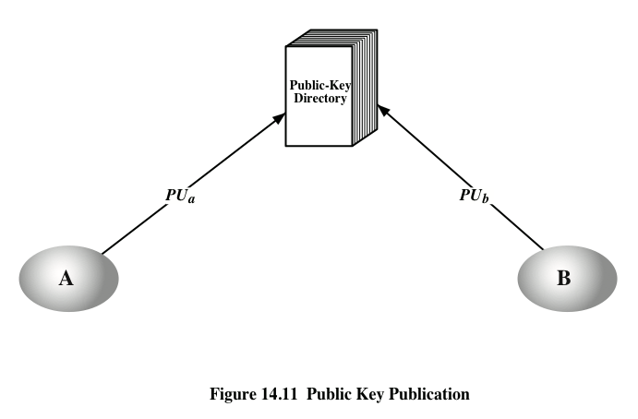
Publicly Available Directory
Notes:
A greater degree of security can be achieved by maintaining a publicly available
dynamic directory of public keys. Maintenance and distribution of the public
directory would have to be the responsibility of some trusted entity or organization
(Figure 14.11). Such a scheme would include the following elements:
1. The authority maintains a directory with a {name, public key} entry for each
participant.
2. Each participant registers a public key with the directory authority.
Registration would have to be in person or by some form of secure authenticated
communication.
3. A participant may replace the existing key with a new one at any time, either
because of the desire to replace a public key that has already been used for a
large amount of data, or because the corresponding private key has been compromised
in some way.
4. Participants could also access the directory electronically. For this purpose,
secure, authenticated communication from the authority to the participant is
mandatory.
This scheme is clearly more secure than individual public announcements
but still has vulnerabilities. If an adversary succeeds in obtaining or computing the
private key of the directory authority, the adversary could authoritatively pass out
counterfeit public keys and subsequently impersonate any participant and eavesdrop
on messages sent to any participant. Another way to achieve the same end is
for the adversary to tamper with the records kept by the authority.

Slide 21
Publicly Available Directory
Can obtain greater security by registering keys with a public directory
Directory must be trusted with properties:
  contains {name,public-key} entries
  participants register securely with directory
  participants can replace key at any time
  directory is periodically published
  directory can be accessed electronically
Still vulnerable to tampering or forgery
CEG 260, Meilin Liu
Notes:
Zili Shao
A greater degree of security can be achieved by maintaining a publicly available dynamic directory of public keys. Maintenance and distribution of the public directory would have to be the responsibility of some trusted entity or organization. This scheme is clearly more secure than individual public announcements but still has vulnerabilities to tampering or forgery.

Slide 22
Public-Key Authority
Improve security by tightening control over distribution of keys from directory
Has properties of directory
And requires users to know public key for the directory
Then users interact with directory to obtain any desired public key securely
  does require real-time access to directory when keys are needed
CEG 260, Meilin Liu
Notes:
Zili Shao
Stronger security for public-key distribution can be achieved by providing tighter control over the distribution of public keys from the directory. It requires users to know the public key for the directory, and that they interact with directory in real-time to obtain any desired public key securely. Note that a total of seven messages are required, as shown next.

Slide 23
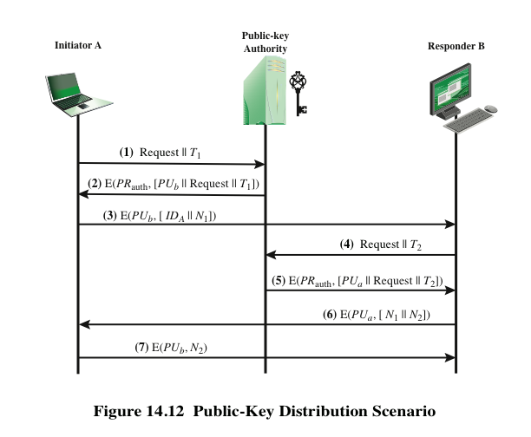
Notes:
Stronger security for public-key distribution can be achieved by providing
tighter control over the distribution of public keys from the directory. A typical
scenario is illustrated in Figure 14.12, which is based on a figure in [POPE79].
As before, the scenario assumes that a central authority maintains a dynamic
directory of public keys of all participants. In addition, each participant reliably
knows a public key for the authority, with only the authority knowing the corresponding
private key.
A total of seven messages are required. However, the initial five messages
need be used only infrequently because both A and B can save the other’s
public key for future use—a technique known as caching. Periodically, a user should
request fresh copies of the public keys of its correspondents to ensure currency.

Slide 24
Public-Key Certificates
Certificates allow key exchange without real-time access to public-key authority
A certificate binds identity to public key
  usually with other info such as period of validity, rights of use etc
With all contents signed by a trusted Public-Key or Certificate Authority (CA)
Can be verified by anyone who knows the public-key authorities public-key
CEG 260, Meilin Liu
Notes:
Zili Shao
An further improvement is to use certificates, which can be used to exchange keys without contacting a public-key authority, in a way that is as reliable as if the keys were obtained directly from a public-key authority. A certificate binds an identity to public key, with all contents signed by a trusted Public-Key or Certificate Authority (CA). This can be verified by anyone who knows the public-key authorities public-key.
One scheme has become universally accepted for formatting public-key certificates: the X.509 standard. X.509 certificates are used in most network security applications, including IP security, secure sockets layer (SSL), secure electronic transactions (SET), and S/MIME. Will discuss it in much more detail later.

Slide 25
Certificates
Certificates containing
  Identity of principal (here, Alice)
  Corresponding public key
  Timestamp (when issued)
  Other information (perhaps identity of signer)
signed by trusted authority (here, Cathy)
C_{A} = E(PRauth, {T || IDa ||PUa})
  Cathy<<Alice>>
CEG 260, Meilin Liu
Notes:
Zili Shao

Slide 26
Certificates
  1. Any participant can read a certificate to determine the name and public key of the certificate’s owner.
  2. Any participant can verify that the certificate originated from the certificate authority and is not counterfeit.
  3. Only the certificate authority can create and update certificates.
  4. Any participant can verify the currency of the certificate.
CEG 260, Meilin Liu
Notes:
Zili Shao

Slide 27
Certificates
Certificates containing
  Identity of principal (here, Alice)
  Corresponding public key
  Timestamp (when issued)
  Other information (perhaps identity of signer)
signed by trusted authority (here, Cathy)
C_{A} = E(PRauth, {T || IDa ||PUa})
  Cathy<<Alice>>
CEG 260, Meilin Liu
Notes:
Zili Shao

Slide 28
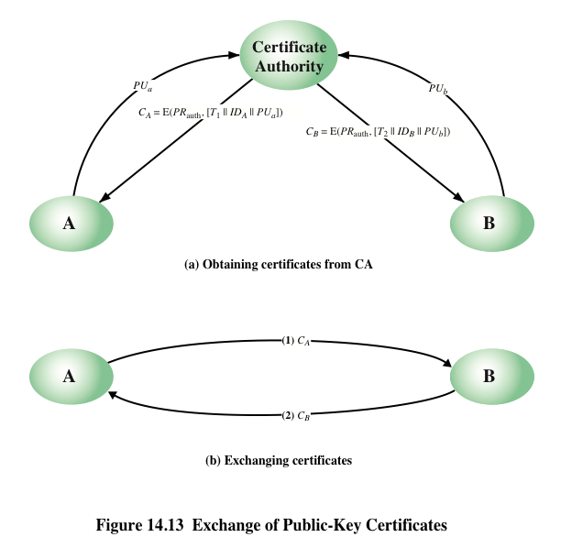
Notes:
The scenario of Figure 14.12 is attractive, yet it has some drawbacks. The public-key
authority could be somewhat of a bottleneck in the system, for a user must appeal
to the authority for a public key for every other user that it wishes to contact. As
before, the directory of names and public keys maintained by the authority is vulnerable
to tampering.
An alternative approach, first suggested by Kohnfelder [KOHN78], is to use
certificates that can be used by participants to exchange keys without contacting a
public-key authority, in a way that is as reliable as if the keys were obtained directly
from a public-key authority. In essence, a certificate consists of a public key, an
identifier of the key owner, and the whole block signed by a trusted third party.
Typically, the third party is a certificate authority, such as a government agency or a
financial institution, that is trusted by the user community. A user can present his or
her public key to the authority in a secure manner and obtain a certificate. The user
can then publish the certificate. Anyone needing this user’s public key can obtain
the certificate and verify that it is valid by way of the attached trusted signature.
A participant can also convey its key information to another by transmitting its
certificate. Other participants can verify that the certificate was created by the
authority. We can place the following requirements on this scheme:
1. Any participant can read a certificate to determine the name and public key of
the certificate’s owner.
2. Any participant can verify that the certificate originated from the certificate
authority and is not counterfeit.
3. Only the certificate authority can create and update certificates.
These requirements are satisfied by the original proposal in [KOHN78]. Denning
[DENN83] added the following additional requirement:
4. Any participant can verify the currency of the certificate.
A certificate scheme is illustrated in Figure 14.13. Each participant applies
to the certificate authority, supplying a public key and requesting a certificate.
Application must be in person or by some form of secure authenticated communication.

Slide 29
Issuers
Certification Authority (CA): entity that issues certificates
  Multiple issuers pose validation problem
  Alice’s CA is Cathy; Bob’s CA is Don; how can Alice validate Bob’s certificate?
  Have Cathy and Don cross-certify
    Each issues certificate for the other
CEG 260, Meilin Liu
Notes:
Zili Shao

Slide 30
Validation and Cross-Certifying
Certificates:
  Cathy<<Alice>>
  Dan<<Bob>
  Cathy<<Dan>>
  Dan<<Cathy>>
Alice validates Bob’s certificate
  Alice obtains Cathy<<Dan>>
  Alice uses (known) public key of Cathy to validate Cathy<<Dan>>
  Alice uses Cathy<<Dan>> to validate Dan<<Bob>>
CEG 260, Meilin Liu
Notes:
Zili Shao

Slide 31
Validating Certificates
Alice needs to validate Bob’s OpenPGP cert
  Does not know Fred, Giselle, or Ellen
Alice gets Giselle’s cert
  Knows Henry slightly, but his signature is at “casual” level of trust
Alice gets Ellen’s cert
  Knows Jack, so uses his cert to validate Ellen’s, then hers to validate Bob’s
Arrows show signatures
Self signatures not shown
Jack
Henry
Ellen
Irene
Giselle
Fred
Bob
CEG 260, Meilin Liu
Notes:
Zili Shao

Slide 32
Public-Key Distribution of Secret Keys
Use previous methods to obtain public-key
Can use for secrecy or authentication
But public-key algorithms are slow
So usually want to use private-key encryption to protect message contents
Hence need a session key
Have several alternatives for negotiating a suitable session
CEG 260, Meilin Liu
Notes:
Zili Shao
Once public keys have been distributed or have become accessible, secure communication that thwarts eavesdropping, tampering, or both, is possible. However, few users will wish to make exclusive use of public-key encryption for communication because of the relatively slow data rates that can be achieved. Accordingly, public-key encryption provides for the distribution of secret keys to be used for conventional encryption.

Slide 33
Simple Secret Key Distribution
Proposed by Merkle in 1979
  A generates a new temporary public key pair
  A sends B the public key and its identity
  B generates a session key K sends it to A encrypted using the supplied public key
  A decrypts the session key and both use
Problem is that an opponent can intercept and impersonate both halves of protocol
CEG 260, Meilin Liu
Notes:
Zili Shao
An extremely simple scheme was put forward by Merkle [MERK79]. But it is insecure against an adversary who can intercept messages and then either relay the intercepted message or substitute another message. Such an attack is known as a man-in-the-middle attack [RIVE84].

Slide 34
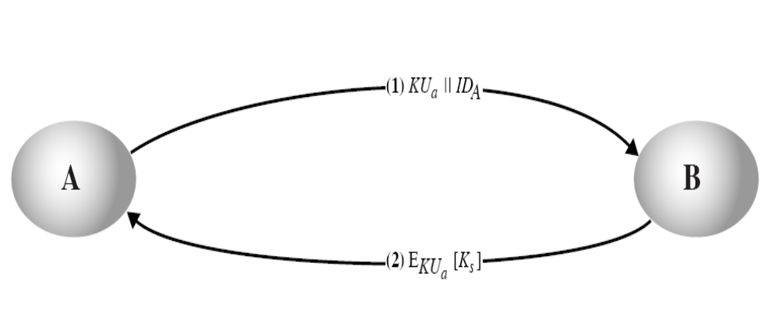
Establish Session Key by Simple Use of Public-Key Encryption
CEG 260, Meilin Liu
Notes:
Zili Shao
All security policies and mechanisms rest on assumptions; we’ll examine some in later chapters, most notably Chapter 22, Malicious Logic. Here is a taste of the assumptions.
Policies: as these define security, they have to define security correctly for the particular site. For example, a web site has to be available, but if the security policy does not mention availability, the definition of security is inappropriate for the site. Also, a policy may not specify whether a particular state is “secure” or “non-secure.” This ambiguity causes problems.
Mechanisms: as these enforce policy, they must be appropriate. For example, cryptography does not assure availability, so using cryptography in the above situation won’t work. Further, security mechanisms rely on supporting infrastructure, such as compilers, libraries, the hardware, and networks to work correctly. Ken Thompson’s modified C preprocessor (see the example on p. 615) illustrates this point very well.

Slide 35
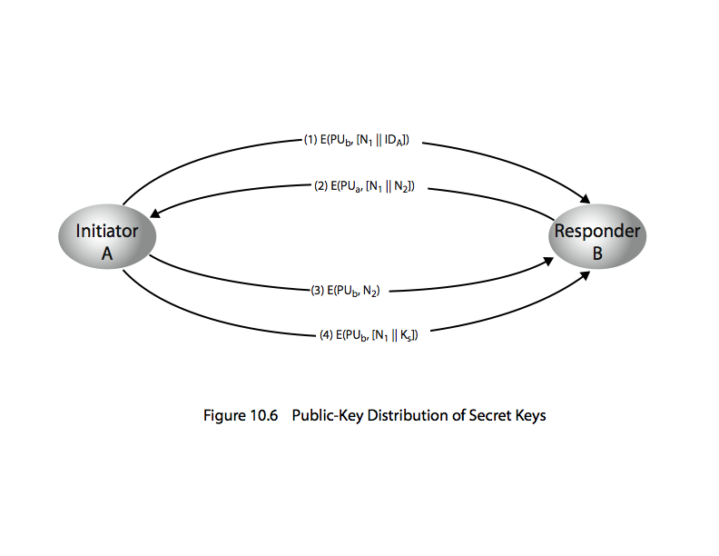
Public-Key Distribution of Secret Keys
if have securely exchanged public-keys:
CEG 260, Meilin Liu
Notes:
Zili Shao
Stallings Figure 10.6 “Public-Key Distribution of Secret Keys” illustrates such an exchange. See text for details of steps in protocol. Note that these steps correspond to final 3 of Figure 10.3, hence can get both secret key exchange and authentication in a single protocol.

Slide 36
Hybrid Key Distribution
retain use of private-key KDC
shares secret master key with each user
distributes session key using master key
public-key used to distribute master keys
  especially useful with widely distributed users
rationale
  performance
  backward compatibility
CEG 260, Meilin Liu
Notes:
Zili Shao
Yet another way to use public-key encryption to distribute secret keys is a hybrid approach in use on IBM mainframes [LE93]. This scheme retains the use of a key distribution center (KDC) that shares a secret master key with each user and distributes secret session keys encrypted with the master key. A public key scheme is used to distribute the master keys. The addition of a public-key layer provides a secure, efficient means of distributing master keys. This is an advantage in a configuration in which a single KDC serves a widely distributed set of users.

